Slide 1
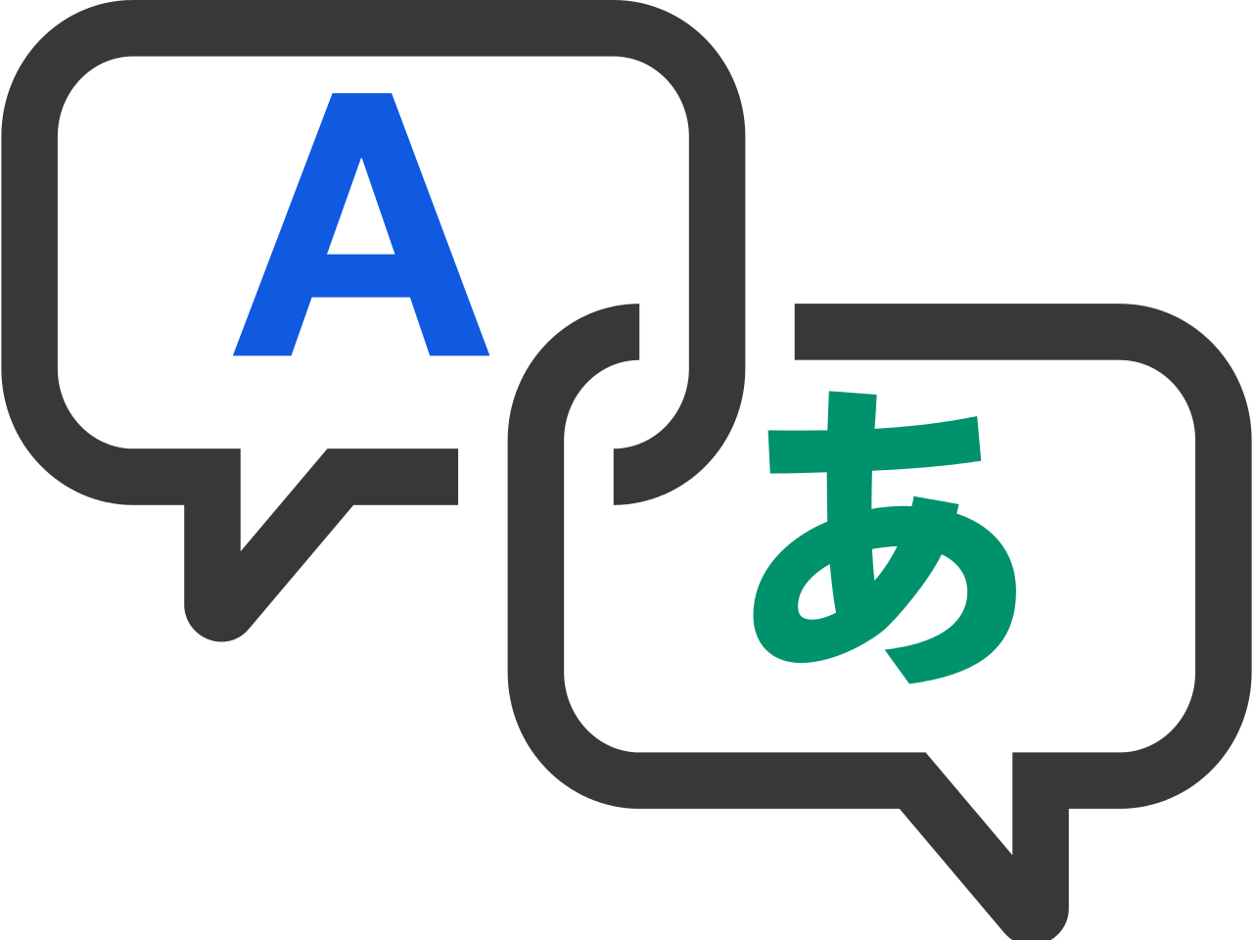
Language Translator
A Software Development Project using Python
Submitted by Vikas and Ashutosh

Slide 2
Technologies used
Tkinter
Google Translator APIs
Python 3.8

Slide 3
Tkinter
Tkinter provides powerful GUI based widgets and functions which create a visually appealing and highly creative application in just a few lines of codes. Tkinter is famous for creating a GUI application because it opens up in a new window where the user can interact with the application.
Tkinter commonly comes bundled with Python, using Tk and is Python's standard GUI framework.
It is famous for its simplicity and graphical user interface. It is open-source and available under the Python License.

Slide 4
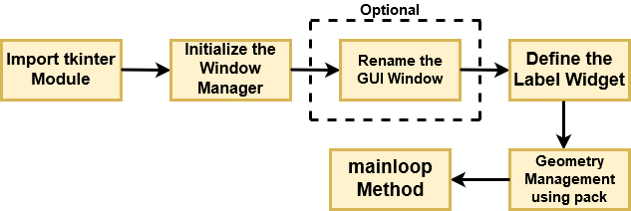
Now, let's build a very simple GUI with the help of Tkinter and understand it with the help of a flow diagram

Slide 5
Google translator APIs
Googletrans is a free and unlimited python library that implemented Google Translate API. This uses the Google Translate Ajax API to make calls to such methods as detect and translate.
googletrans is a module to translate text. We import the Translator from googletrans, which is used to do translations.
We also import LANGUAGES from googletrans which lists all supported languages in a Python dictionary.

Slide 6
Features of googletrans
Fast and reliable - it uses the same servers that translate.google.com uses
Auto language detection
Bulk translations
Customizable service URL
Connection pooling (the advantage of using requests.Session)
HTTP/2 support

Slide 7
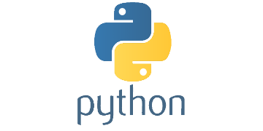
Python 3
Python is a general-purpose, versatile and popular programming language. It’s great as a first language because it is concise and easy to read, and it is also a good language to have in any programmer’s stack as it can be used for everything from web development to software development and data science applications.

Slide 8
Working of Translator

Slide 9
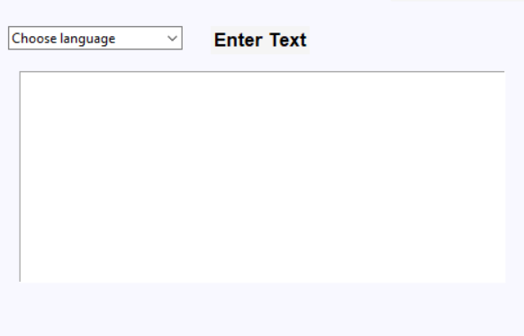
Input Section In this section you can choose the language which should be translated and in the text area you can write your sentence.

Slide 10
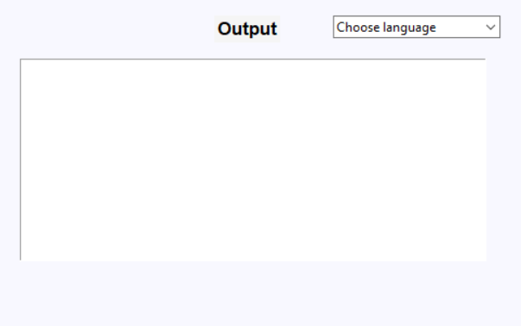
Output section In this section you will get the translated text in text area in desired language

Slide 11
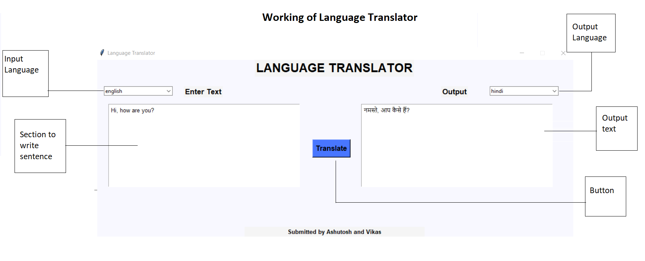
Overview of the Translator app It is the complete GUI overview of the translator app, here you can see all the fields which are provided to make it more reliable to use, it consists a text area for input and output, a button and option for input and output languages.

Slide 12
Thank you!

